Slide 1
Category review: Chips
August 2023
Retail Analytics
Brand note: If client logo is not required, use alternate title page layout right click slide thumbnail > Layout > Title

Slide 2
Executive summary
Brand name influences customer purchases
01
Task 1
02
Task 2
Trial period increased sales for the specified trial stores

Slide 3
01
Category

Slide 4
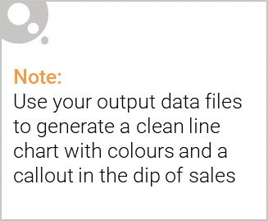
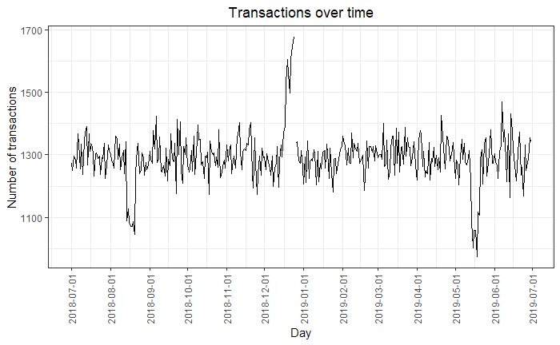
Overview: How Brand Increases Sales
Recent sales encouraged more findings in customer analytics and findings
Focused on specific customer segments to proportionately supply stores with the right product

Slide 5

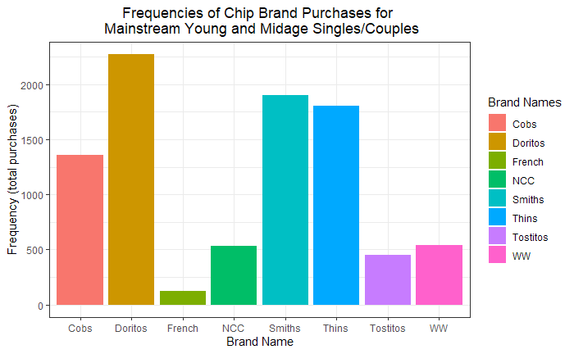
Doritos, Smiths, and Thins are the 3 most popular chip brands for Mainstream Young and Midage Singles/Couples

Slide 6
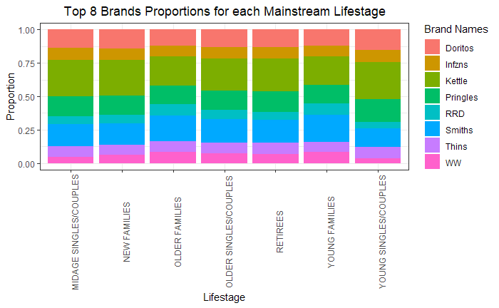
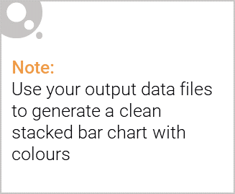
Editable (delete this)

Slide 7
02
Trial store performance

Slide 8
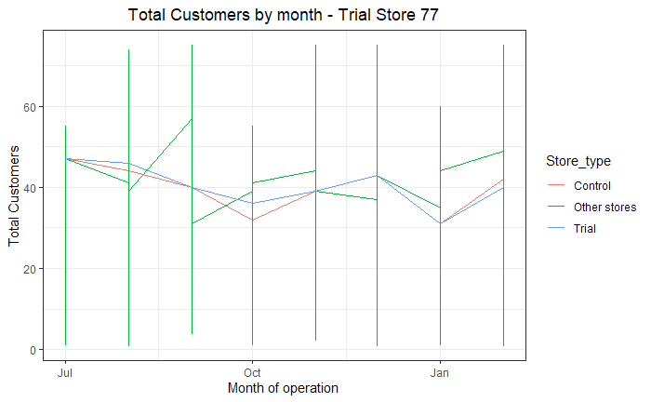
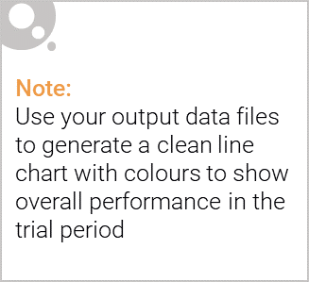
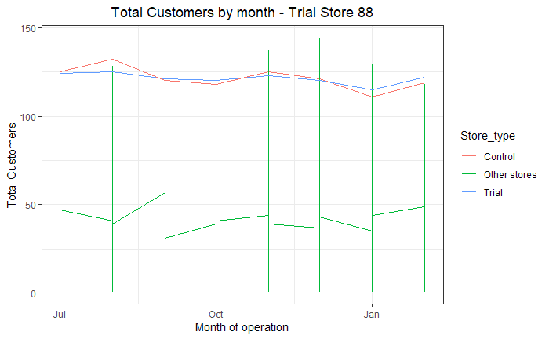
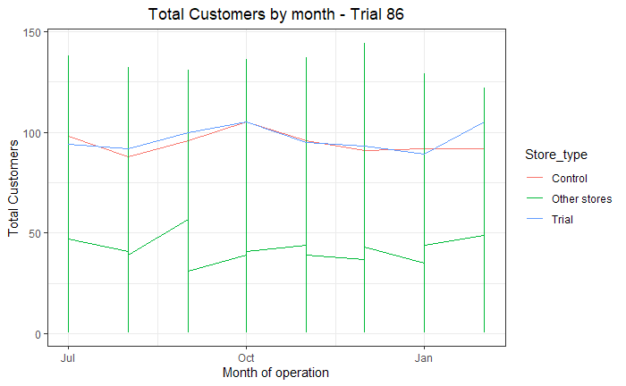
Explanation of the control store vs other stores
“Control Store” - store that has a similar performance to the trial store
Achieved through creating a custom scoring metric for the store’s sales and customer data
Whether sales or customer amount, each store’s metric was scaled for each month
Then, the average of store’s metrics was calculated
The averages were plugged into the Score Formula
The store with the highest score is the “control store” for that trial store

Slide 9
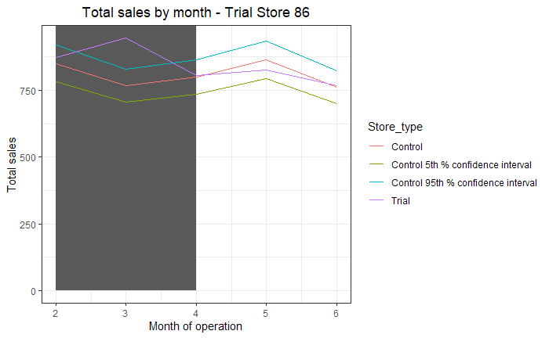
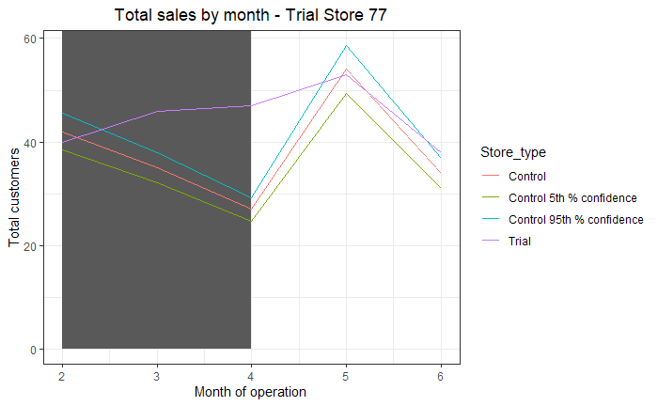
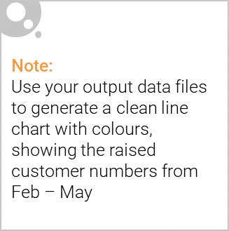
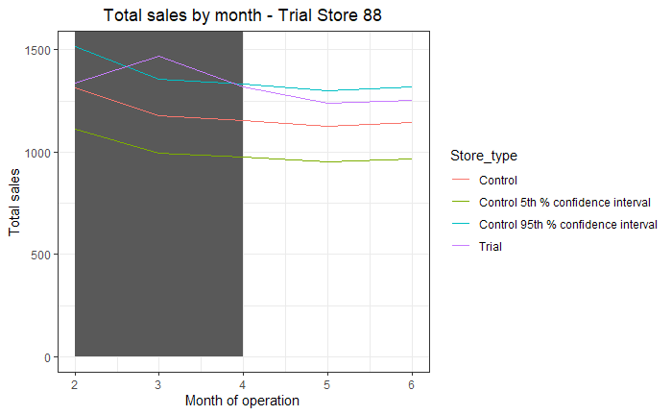
Sales of Control stores were standardized and scaled to the sales of the Trial store
All trial stores’ means are statistically higher than the control’s during the Feb - May period (p-values close to 0)

